Slide 1


Database Tutorial
For PostgreSQL, Cassandra, and Elastic Search

Slide 2
Postgres Basic Commands
To connect:
\l - list databases
\connect dbname
\dt list tables
\connect postgres
select * from public."Movies";

Slide 3
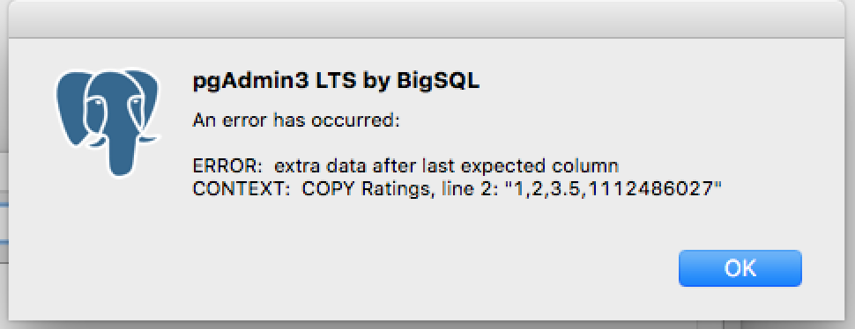
First Bug: extra data after last expected column
Solved:
Added columns manually to table and then selected them on the “columns” tab when going to import

Slide 4
Imported 2 Tables in Postgres
Movies has 28,000 rows
Ratings has 20,000,000 rows
Selects
select title from public."Movies";
OR
Select title from “Movies”
JOIN query on movieId

Slide 5
Outer Join in Postgres
Movies = movieId, title, genres
Ratings = userId, movieId, rating, timestamp
SELECT title, rating FROM public."Movies" m FULL OUTER JOIN public."Ratings" r ON r.movieId = m.movieId;
SELECT title, rating FROM public."Movies" FULL OUTER JOIN public."Ratings" ON public."Ratings".movieId = public."Movies".movieId;
**Does not work
***I fixed the column name in public.”Movies”

Slide 6
Other Queries
Cross Join
select * from public."Movies" CROSS JOIN public."Ratings";
Got a weird error
Im done trying to join

Slide 7
Running Apache Cassandra 3.11.3
To run Cassandra
launchctl load /usr/local/opt/cassandra/homebrew.mxcl.cassandra.plist
Cqlsh
cqlsh> DESCRIBE keyspaces;
cqlsh> use "Movies";
describe tables;
use “Ratings”; #switches keyspaces

Slide 8
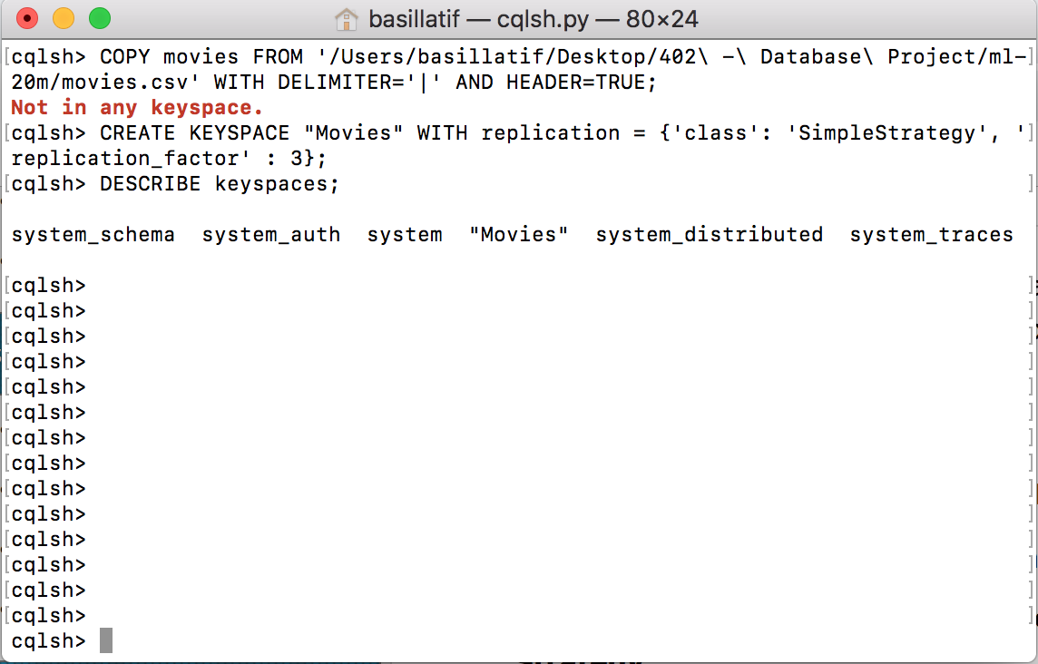
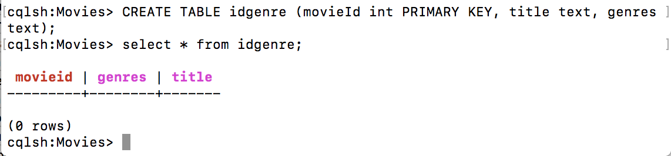
Preparing Keyspace and Tables
First, create a keyspace. Verify it exists.
Next, create a table and verify it exists

Slide 9
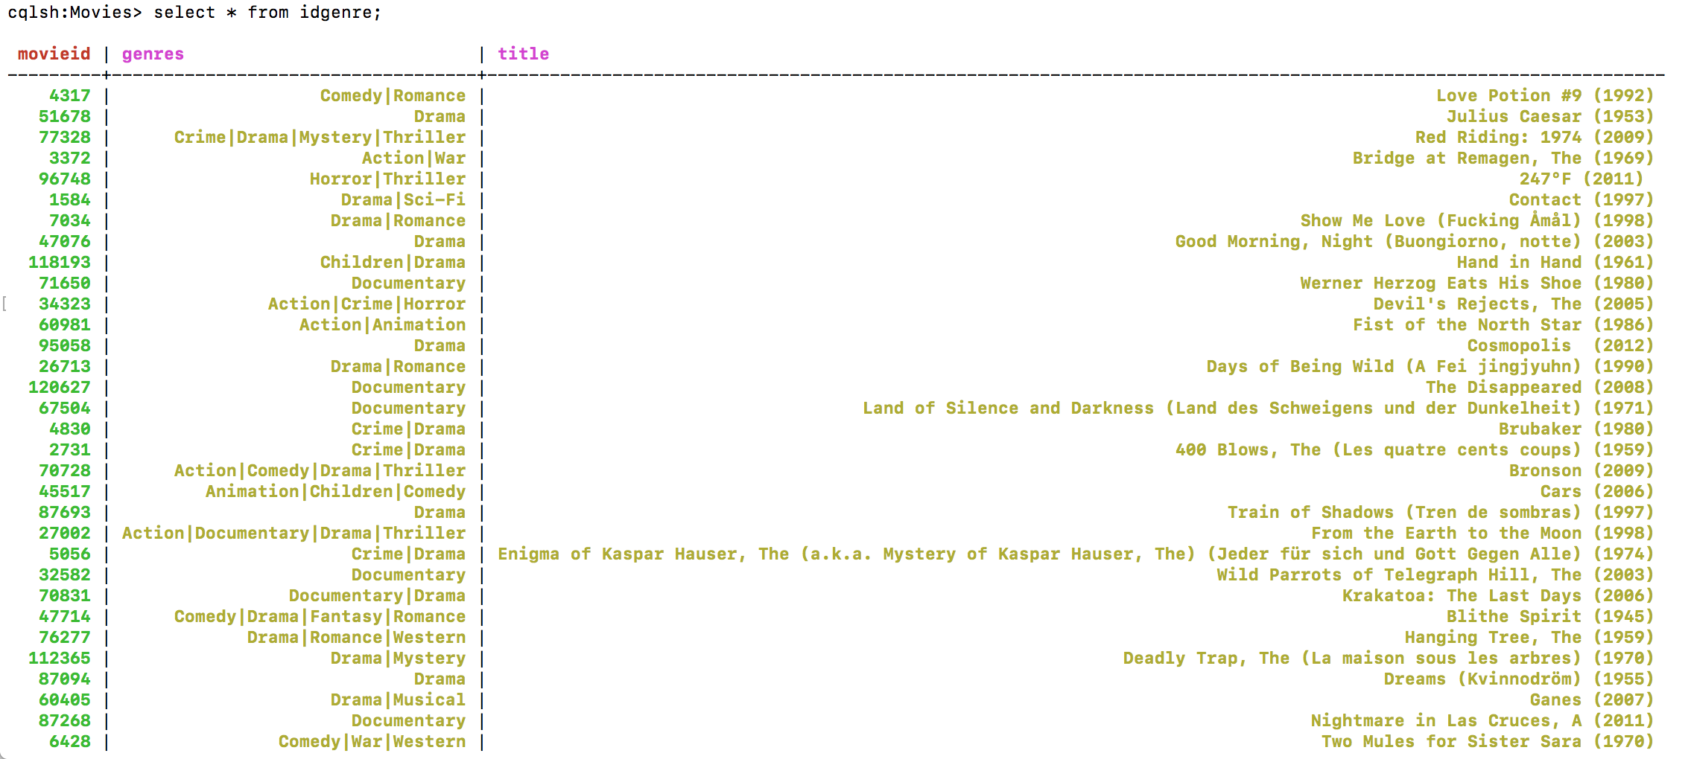
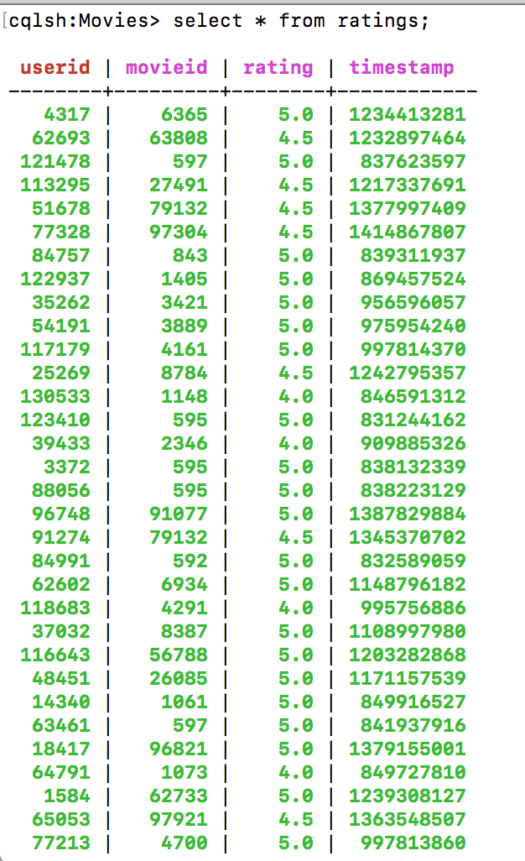
Import data into Cassandra
Worked after I put file on desktop
“Movies” Table
cqlsh:Movies> COPY idgenre (movieID,title,genres) FROM '/Users/basillatif/Desktop/movies.csv' WITH HEADER = TRUE;
Ratings Table cqlsh:Movies> COPY ratings (userid,movieid,rating,timestamp) FROM '/Users/basillatif/Desktop/ratings.csv' WITH HEADER = TRUE;

Slide 10
Queries in Cassandra
Query the entire table
select * from ratings;
select * from idgenre;

Slide 11
Elastic Search CSV Importer
Use logstash to load csv into Elastic Search
https://www.youtube.com/watch?v=rKy4sFbIZ3U
Logstash Job Kibana Visualization
https://www.youtube.com/watch?v=imrKm6dV3NQ

Slide 12
Running Elastic Search
Cd into elastic search folder
bin/elasticsearch
Cd into kibana folder
bin/kibana in a new Terminal window
Go to localhost:5601
New terminal window:
Cd into logstash folder
bin/logstash -f /Users/basillatif/Desktop/402\ -\ Database\ Project/data/logstash_idgenre.config
Localhost:5601

Slide 13
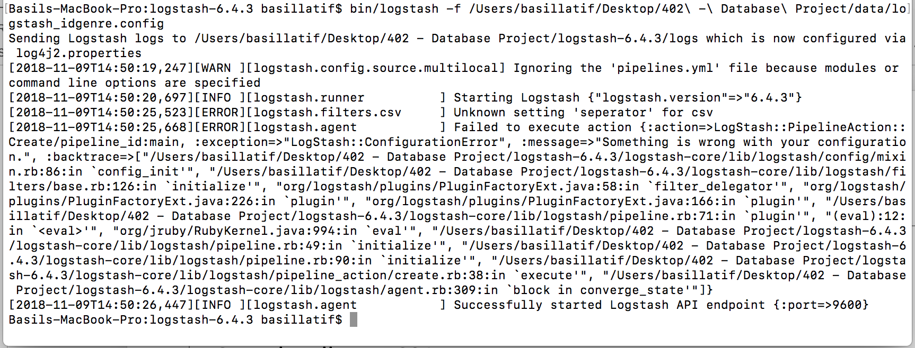
Error
I spelled separator wrong
I had the wrong path for the file
Had to download latest version of elastic search

Slide 14
Queries to Benchmark
Postgres Cassandra ElasticSearch
Select * on Ratings Table
Trial 1: 35.47 Trial 1: 1.66 seconds
Trial 2: 30.25 Trial 2: .55 seconds
Trial 3: 29.13 Trial 3: .40 seconds
Avg: 31.62 Avg: .87 seconds
No joins in Cassandra

Slide 15
The ELK Stack

Slide 16
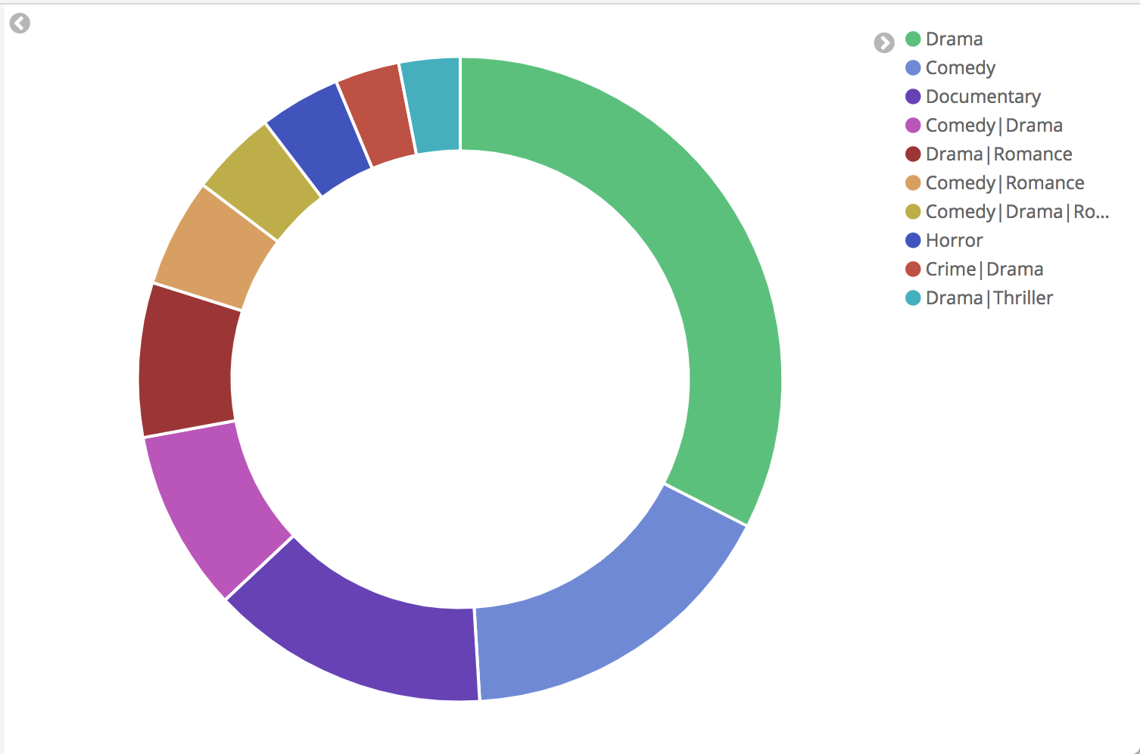
Visualization in Kibana
Most common movie genres

